Slide 1
Pipeline II: Control Hazards, Data Hazards I
Take-home midterm logistics
https://edstem.org/us/courses/25846/discussion/1953640

Slide 2
RISC-V’s 5-Stage Pipeline
RISC-V’s 5-Stage Pipeline
Pipelined Datapath and Control
Structural Hazards
Data Hazards I (Stalling, Forwarding)

Slide 3
Single-Cycle RV32I Datapath
Review
IF
ID
EX
MEM
WB
+4
add
pc+4
dataW
rsW
rsR1 dataR1
rsR2
dataR2
Reg[]
pc+4
R[rs1]
PC
inst[11:7]
inst[19:15]
inst[24:20]
alu
2
1
0
0
1
addr
inst
IMEM
Branch Comp.
pc
1
0
A
ALU
B
dataR
addr
DMEM
dataW
alu
mem
clk
0
1
inst[31:7]
Imm. Gen
clk
R[rs2]
imm[31:0]
clk
Instruction Fetch
(IMEM Read)
Instruction Decode
(Reg Read)
Execute
ALU
Memory Access (DMEM)
Write back to register (Reg write)

Slide 4
Single-Cycle RV32I Datapath
Review
IF
ID
EX
MEM
WB
+4
add
pc+4
dataW
rsW
rsR1 dataR1
rsR2
dataR2
Reg[]
pc+4
R[rs1]
PC
inst[11:7]
inst[19:15]
inst[24:20]
alu
2
1
0
0
1
addr
inst
IMEM
Branch Comp.
pc
1
0
A
ALU
B
dataR
addr
DMEM
dataW
alu
mem
clk
0
1
inst[31:7]
Imm. Gen
clk
R[rs2]
imm[31:0]
clk
Instruction Fetch
(IMEM Read)
Instruction Decode
(Reg Read)
Execute
ALU
Memory Access (DMEM)
Write back to register (Reg write)

Slide 5
Symbolic Representation of 5 Stages
IF
ID
EX
MEM
WB
ID, WB stages respectively read and write the same hardware element, Reg (RegFile).
IMEM
Reg
ALU
DMEM
Reg
200 ps
100 ps
200 ps
200 ps
100 ps
Instruction Fetch
(IMEM Read)
Instruction Decode
(Reg Read)
Execute
ALU
Memory Access (DMEM)
Write back to register (Reg write)

Slide 6




“Sequential” RISC-V Datapath
In a single-cycle CPU, only one instruction can access any resources in one clock cycle, in sequence.
$$t_{instruction}$$
$$t_{instruction}$$
$$t_{instruction}$$
add t0,t1,t2
or t3,t4,t5
lw t0,8(t3)
$t_{cycle}$ = 800 ps

Slide 7

Pipelined RISC-V Datapath
In a pipelined CPU, multiple instructions access resources in one clock cycle.
$$t_{instruction}$$
add t0,t1,t2
or t3,t4,t5
lw t0,8(t3)
$t_{cycle}$
= 200 ps

Slide 8
What Happens Sequentially? Simultaneously?
time
Simultaneous: Resource use by multiple instructions in same clock cycle.
add t0,t1,t2
lw t0,8(t3)
or t3,t4,t5
sw t0,4(t3)
sll t6,t0,t3
Sequential: Resource use by same instruction over time (multiple clock cycles)

Slide 9
Performance (1/2): Latency
add t0,t1,t2
or t3,t4,t5
lw t0,8(t3)
 | Single Cycle | Pipelined
Timing of each stage | $t_{stage}$ = 200, 100, 200, 200, 100 ps (Reg access stages ID, WB only 100 ps) | $t_{stage}=$ 200 ps All stages same length
Instruction time (Latency) | $t_{instruction}$ = 800 ps | $t_{instruction}=5⋅t_{cycle}$ = 1000 ps
The pipelined CPU uses one clock for all stages; clock cycle time is limited by the slower stages.
Notes:
Wikipedia: https://en.wikipedia.org/wiki/Cycles_per_instruction
With pipelining, a new instruction is fetched every clock cycle by exploiting instruction-level parallelism, therefore, since one could theoretically have five instructions in the five pipeline stages at once (one instruction per stage), a different instruction would complete stage 5 in every clock cycle and on average the number of clock cycles it takes to execute an instruction is 1 (CPI = 1).

Slide 10



Performance (2/2): Throughput
“Iron Law” of Processor Performance:
$$\frac{time}{program}=\frac{instructions}{program}×\frac{cycles}{instruction} × \frac{time}{cycle}$$
1/throughput
CPI, inverse of (# instrs executed/cycle)
$$t_{cycle}$$
$$\frac{\# instructions}{time}$$
Processor Throughput:
 | Single Cycle | Pipelined
Timing of each stage | $t_{stage}$ = 200, 100, 200, 200, 100 ps (Reg access stages ID, WB only 100 ps) | $t_{stage}=$ 200 ps All stages same length
Instruction time (Latency) | $t_{instruction}$ = 800 ps | $t_{instruction}=5⋅t_{cycle}$ = 1000 ps
Clock cycle time, $t_{cycle}$ Clock rate, $f_{s}=1/t_{cycle}$ | $t_{cycle}=t_{instruction}$ = 800 ps $f_{s}$ = 1/800 ps = 1.25 GHz | $t_{cycle}=t_{stage}$ = 200 ps $f_{s}$ = 1/200 ps = 5 GHz
CPI (Cycles Per Instruction) | ~1 (ideal) | ~1 (ideal) <1 (actual, more later/CS152)
Relative throughput gain | 1 x | 4 x
Notes:
Wikipedia: https://en.wikipedia.org/wiki/Cycles_per_instruction
With pipelining, a new instruction is fetched every clock cycle by exploiting instruction-level parallelism, therefore, since one could theoretically have five instructions in the five pipeline stages at once (one instruction per stage), a different instruction would complete stage 5 in every clock cycle and on average the number of clock cycles it takes to execute an instruction is 1 (CPI = 1).

Slide 11
Pipelined Datapath and Control
RISC-V’s 5-Stage Pipeline
Pipelined Datapath and Control
Structural Hazards
Data Hazards I (Stalling, Forwarding)

Slide 12
Constructing a Pipelined RV32I Datapath
IF
ID
EX
MEM
WB
+4
add
pc+4
dataW
rsW
rsR1 dataR1
rsR2
dataR2
Reg[]
pc+4
R[rs1]
PC
inst[11:7]
inst[19:15]
inst[24:20]
alu
2
1
0
0
1
addr
inst
IMEM
Branch Comp.
pc
1
0
A
ALU
B
dataR
addr
DMEM
dataW
alu
mem
clk
0
1
inst[31:7]
Imm. Gen
clk
R[rs2]
imm[31:0]
clk
A pipelined datapath needs to “separate” the five stages of the RV32I datapath.
Each stage needs to process data from a different instruction.
Use pipeline registers to carry instruction data between stages!

Slide 13
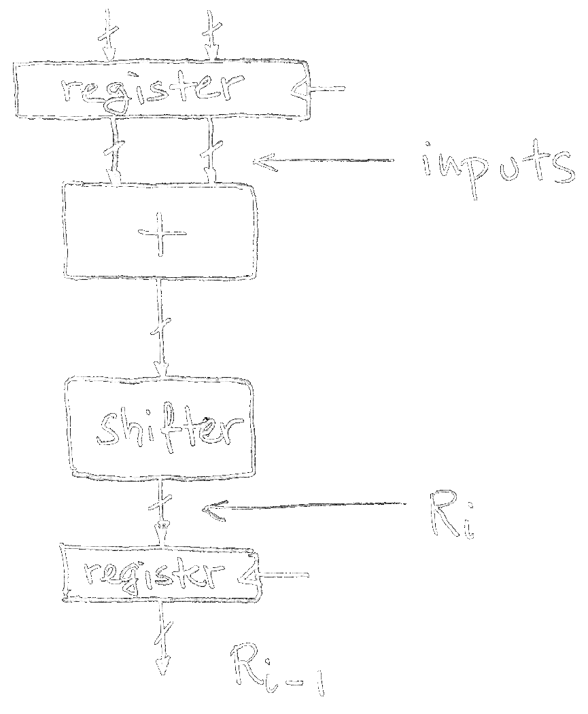
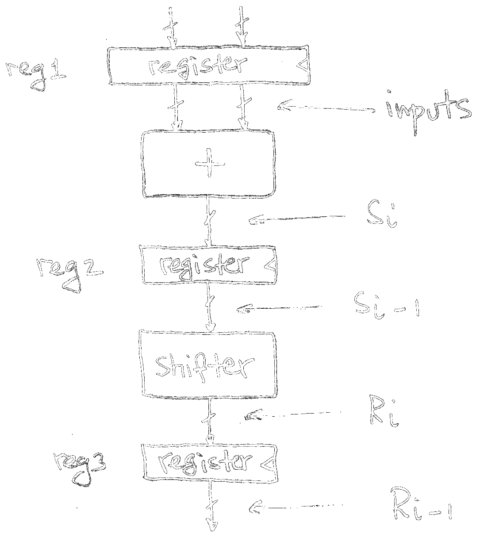
Pipelining to improve performance
Review
Single-cycle datapath means 1 clock cycle, from input to output.
Clock period limited by propagation delays of adder and shifter.
Insertion of pipeline register allows higher clock frequency.
Clock period now limited by max {adder/shifter prop. delays}.
Higher throughput (outputs/s).
Pipeline Register

Slide 14
IF/ID Pipeline Registers
IF
ID
EX
MEM
WB
+4
add
+4
add
dataW
rsW
rsR1 dataR1
rsR2
dataR2
Reg[]
PC
PC_{ID}
2
1
0
0
1
addr
inst
IMEM
Branch Comp.
1
0
A
ALU
B
dataR
addr
DMEM
dataW
inst_{ID}
clk
0
1
Imm. Gen
clk
IF/ID has two pipeline registers: PC_{ID}, inst_{ID}.
Increment PC to PC + 4 for next cycle’s IF stage.
clk
IF/ID
ID/EX
EX/MEM
MEM/WB
Notes:
IF/ID: 32-b PC address, 32-b instruction
ID/EX: immediate, R[rs1], R[rs2], PC address, 32-b instruction
EX/MEM: R[rs2], PC, ALU, instruction
MEM/WB: ALU, mem, PC+4, instruction

Slide 15
ID/EX Pipeline Registers
IF
ID
EX
MEM
WB
+4
add
PC_{EX}
+4
add
dataW
rsW
rsR1 dataR1
rsR2
dataR2
Reg[]
rs1_{EX}
PC
PC_{ID}
2
1
0
0
1
addr
inst
IMEM
Branch Comp.
1
0
A
ALU
B
dataR
addr
DMEM
dataW
inst_{ID}
clk
0
1
Imm. Gen
clk
rs2_{EX}
Pipe instruction along with data to correctly operate control in each stage.
imm_{EX}
clk
inst_{EX}
IF/ID
ID/EX
EX/MEM
MEM/WB
Notes:
IF/ID: 32-b PC address, 32-b instruction
ID/EX: immediate, R[rs1], R[rs2], PC address, 32-b instruction
EX/MEM: R[rs2], PC, ALU, instruction
MEM/WB: ALU, mem, PC+4, instruction

Slide 16
EX/MEM Pipeline Registers
IF
ID
EX
MEM
WB
+4
add
PC_{EX}
+4
add
dataW
rsW
rsR1 dataR1
rsR2
dataR2
Reg[]
rs1_{EX}
PC_{MEM}
PC
PC_{ID}
alu_{MEM}
2
1
0
0
1
addr
inst
IMEM
Branch Comp.
1
0
A
ALU
B
dataR
addr
DMEM
dataW
inst_{ID}
clk
0
1
Imm. Gen
clk
rs2_{EX}
rs2_{MEM}
imm_{EX}
clk
inst_{EX}
inst_{MEM}
IF/ID
ID/EX
EX/MEM
MEM/WB
rs2 (data to store) needs to be piped through to MEM.
Notes:
IF/ID: 32-b PC address, 32-b instruction
ID/EX: immediate, R[rs1], R[rs2], PC address, 32-b instruction
EX/MEM: R[rs2], PC, ALU, instruction
MEM/WB: ALU, mem, PC+4, instruction

Slide 17
MEM/WB Pipeline Registers
Recalculate PC+4 to avoid sending both PC, PC+4 down pipeline.
IF
ID
EX
MEM
WB
+4
add
PC_{EX}
+4
add
PC+4_{WB}
dataW
rsW
rsR1 dataR1
rsR2
dataR2
Reg[]
rs1_{EX}
PC_{MEM}
PC
PC_{ID}
alu_{WB}
addr
inst
IMEM
alu_{MEM}
2
1
0
0
1
Branch Comp.
1
0
A
ALU
B
dataR
addr
DMEM
dataW
mem_{WB}
inst_{ID}
clk
0
1
Imm. Gen
clk
rs2_{EX}
rs2_{MEM}
imm_{EX}
clk
inst_{EX}
inst_{MEM}
inst_{WB}
(decode for rsW)
IF/ID
ID/EX
EX/MEM
MEM/WB
Notes:
IF/ID: 32-b PC address, 32-b instruction
ID/EX: immediate, R[rs1], R[rs2], PC address, 32-b instruction
EX/MEM: R[rs2], PC, ALU, instruction
MEM/WB: ALU, mem, PC+4, instruction

Slide 18
Matching Question
Suppose the CPU is currently executing this clock cycle.
How are all simultaneously executing instructions using the pipelined stages of the datapath?
add lw or sw sll
sll sw or lw add
Something else

Slide 19
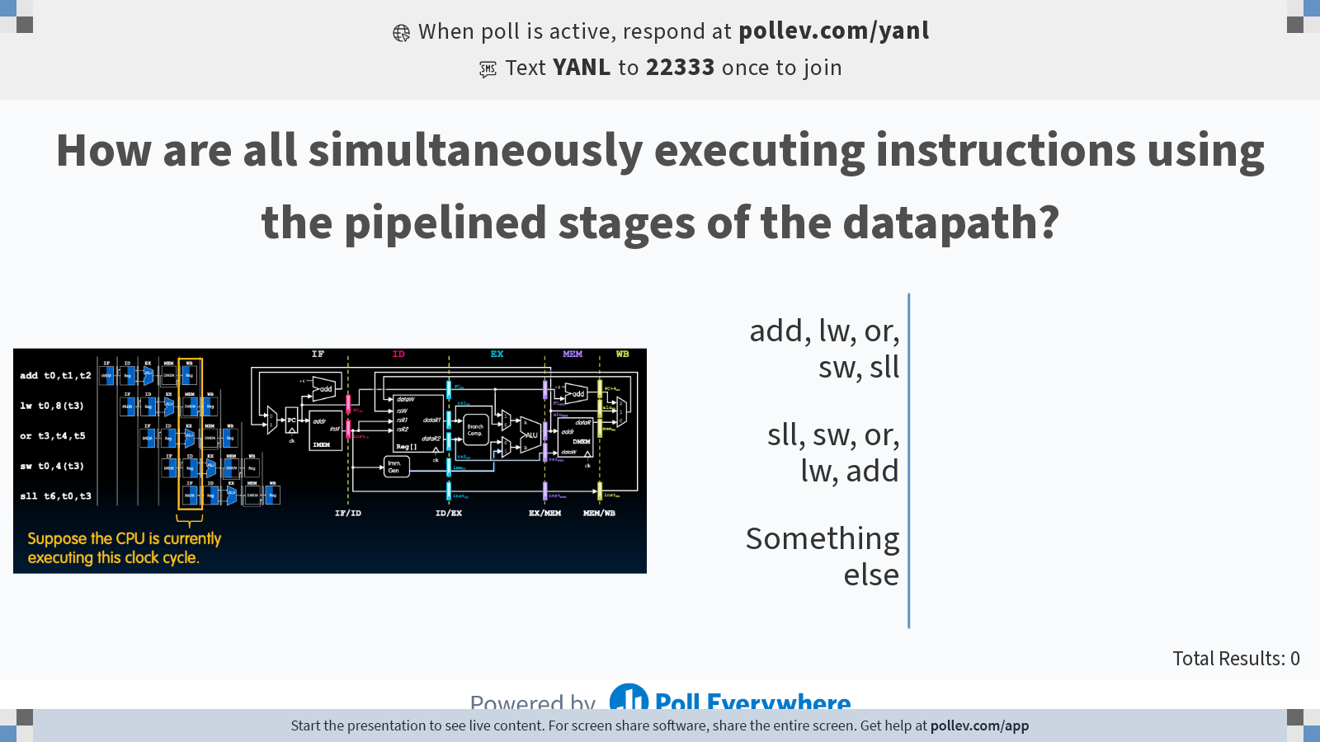
Notes:
Do not modify the notes in this section to avoid tampering with the Poll Everywhere activity. More info at polleverywhere.com/support How are all simultaneously executing instructions using the pipelined stages of the datapath?
https://www.polleverywhere.com/multiple_choice_polls/fiNkePDSCWqgss4pfqkcb?state=opened&flow=Default&onscreen=persist

Slide 20
Matching Solution
lw t0,8(t3)
add t0,t1,t2
Suppose the CPU is currently executing this clock cycle.
sll t6,t0,t3
sw t0,4(t3)
or t3,t4,t5
The leftmost stage (IF) contains the most recent instruction. On the next clock cycle, pipeline registers carry the instruction/data to the next stage (ID).

Slide 21
Control Is Also Pipelined
Control signals are derived from the instruction.
Like in the single-cycle CPU, control is usually computed during instruction decode (ID).
Control information for later stages is stored in pipeline registers.
Example:
WB_{ctrl}
instruction
WB_{ctrl}
Control
MEM_{ctrl}
MEM_{ctrl}
WB_{ctrl}
EX_{ctrl}
(more later on branch computation)
IF/ID
ID/EX
EX/MA
MA/WB

Slide 22
Structural Hazards
RISC-V’s 5-Stage Pipeline
Pipelined Datapath and Control
Structural Hazards
Data Hazards I (Stalling, Forwarding)

Slide 23




Pipeline Hazards Ahead!!!

Slide 24
Pipeline Hazards Ahead!!!
Can we read from memory twice in the same clock cycle?
time
add t0,t1,t2
lw t0,8(t3)
or t3,t4,t5
sw t0,4(t3)
sll t6,t0,t3
add t0,t1,t2
lw t0,8(t3)
or t3,t4,t5
sw t0,4(t3)
sll t6,t0,t3
How does sw’s EX stage get the right value of t3 if or’s WB stage hasn’t executed yet??
How do branches work???

Slide 25
Three Types of Pipeline Hazards
A hazard is a situation in which a planned instruction cannot execute in the “proper” clock cycle.
Structural hazard:
Hardware does not support access across multiple instructions in the same cycle.
Data hazard:
Instructions have data dependency.
Need to wait for previous instruction to complete its data read/write.
Control hazard:
Flow of execution depends on previous instruction.

Slide 26

Structural Hazards
Structural hazard:
Hardware does not support access across multiple instructions in the same cycle.
Occurs when multiple instructions compete for access to a single physical resource.
Solution 1 (inefficient):
Instructions take turns using the resource.
Some instructions stall while the resource is busy.
Solution 2: Add more hardware!
Can always solve structural hazards by adding more HW.
In our current CPU, structural hazards are not an issue.
The RV32I ISA datapath avoids structural hazards via its hardware requirements on RegFile and Memory.

Slide 27
Required RegFile Avoids Structural Hazards
Each RV32I instruction:
Reads up to 2 operands in ID (decode) stage; and
Writes up to 1 operand in WB (writeback) stage.
Structural hazard can occur if RegFile HW does not support simultaneous read/write!
RV32I’s required RegFile design works:
Two independent read ports, one independent write port.
Three accesses (2 read, 1 write) can happen in the same cycle.
add t0,t1,t2
Hazard!
dataW
dataR
rs
32
32
5
❌
RegWEn
clk
dataW
rsW
rs1 data1
rs2
data2
Reg[]
✅
32
5
5
32
5
32
RegWEn
clk

Slide 28
Separate IMEM, DMEM Avoids Structural Hazards
time
CPU can read memory twice in the same cycle:
IF: Instruction memory (IMEM)
MEM: data memory (DMEM)
Structural hazard if IMEM, DMEM were same hardware:
Without separate memories, instruction fetch would have to stall for a cycle.
RV32I’s required separation of IMEM and DMEM works.
add t0,t1,t2
lw t0,8(t3)
or t3,t4,t5
sw t0,4(t3)
sll t6,t0,t3

Slide 29
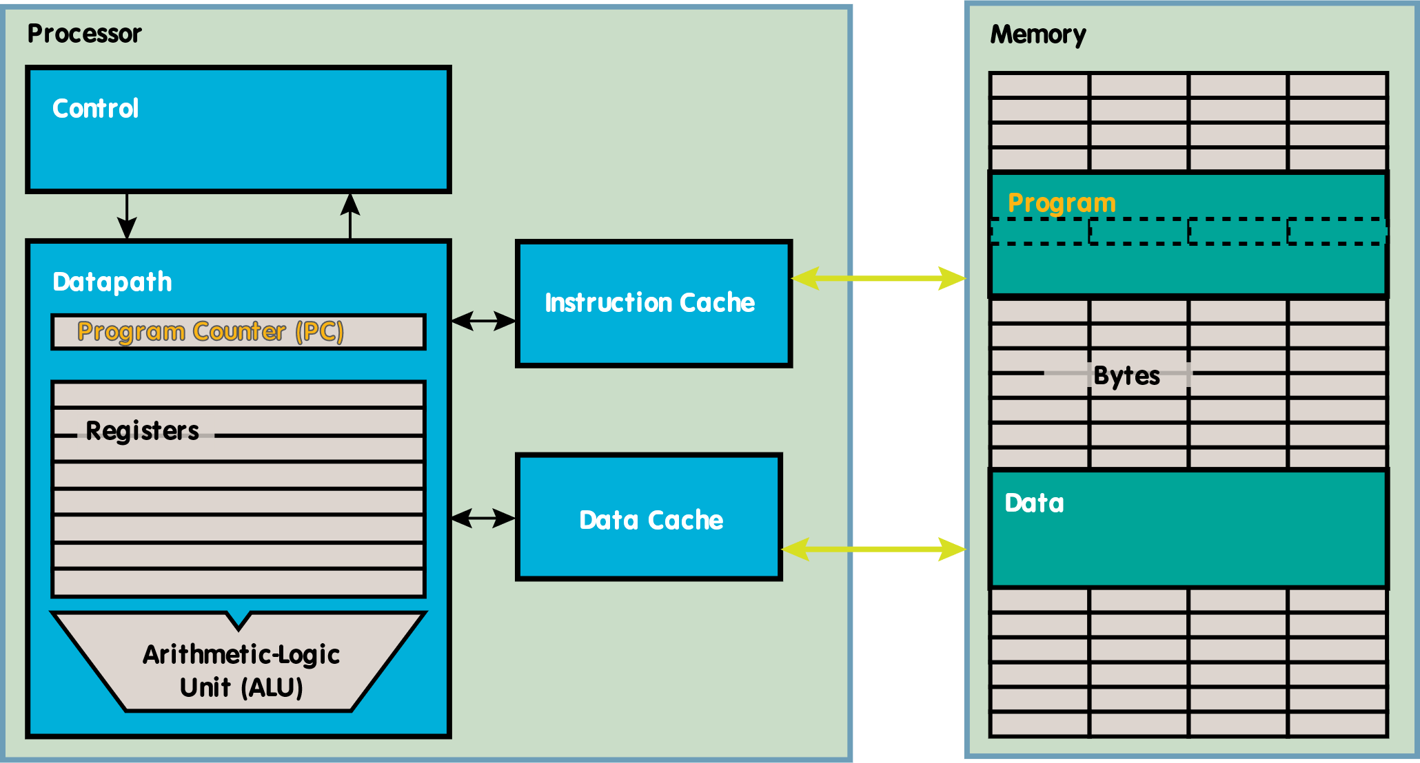
Instruction and Data Caches
Two fast, separate on-chip memories, one for instructions and one for data:
✅
addr
inst
IMEM
32
32
✅
dataR
addr
DMEM
dataW
32
32
32
clk
MemRW

Slide 30
Data Hazards I: (Stalling, Forwarding)
RISC-V’s 5-Stage Pipeline
Pipelined Datapath and Control
Structural Hazards
Data Hazards I (Stalling, Forwarding)

Slide 31
Data Hazards
Data hazard:
Instructions have data dependency.
Need to wait for previous instruction to complete its data read/write.
Occurs when an instruction reads a register before a previous instruction has finished writing to that register.
Three cases to consider:
Register access
ALU Result
Load data hazard (next time)

Slide 32
Data Hazard 1: Register Access
time
If the same register is written and read in one cycle:
WB must write value before ID reads new value.
Not structural hazard! Separate ports allow simultaneous R/W.
add t0,t1,t2
lw t0,8(t3)
or t3,t4,t5
sw t0,4(t3)
sll t6,t0,t3

Slide 33
Register Access, Fixed with HW Requirement
time
If the same register is written and read in one cycle:
WB must write value before ID reads new value.
Not structural hazard! Separate ports allow simultaneous R/W.
Solution: RegFile HW should write-then-read in same cycle.
Exploits high speed of RegFile (100 ps + 100 ps)
Indicated by shading in diagram
Might not always be possible to write-then-read in same cycle, e.g., in high-frequency designs.
add t0,t1,t2
lw t0,8(t3)
or t3,t4,t5
sw t0,4(t3)
sll t6,t0,t3

Slide 34
Data Hazard 2: ALU Result
time
Problem: Instruction depends on WB’s RegFile write from previous instruction.
sub, or’s ID reads old value of s0 and calculates wrong result.
Note: xor gets right value; RegFile is write-then-read.
add s0,t0,t1
sub t2,s0,t0
or t6,s0,t3
xor t5,t1,s0
sw s0,4(t4)
add s0,t0,t1
sub t2,s0,t0
or t6,s0,t3
xor t5,t1,s0
sw s0,4(t4)
⚠️
⚠️
✅
✅
s0 value
5
5
5
5
5/9
9
9
9
9

Slide 35
ALU Solution 1: Stalling
time
“Bubble” to effectively nop:
Affected pipeline stages do nothing during clock cycles.
Stall all stages by preventing PC, IF/ID pipeline register from writing (more in textbook).
add s0,t0,t1
sub → nop
sub → nop
sub t2,s0,t0
or t6,s0,t3
Stalls reduce performance.
Compiler could rearrange code/insert nops to avoid hazards (and therefore stalls), but this requires knowledge of the pipeline structure.
✅
✅
s0 value
5
5
5
5
5/9
9
9
9
9
Notes:
Note: stalls are like explicit nops (addi x0,x0,0), except the latter requires more code space.

Slide 36
ALU Solution 2: Forwarding
time
Forwarding, aka bypassing, uses the result when it is computed.
Don’t wait for value to be stored into RegFile.
Instead, grab operand from the pipeline stage.
9
9
add s0,t0,t1
sub t2,s0,t0
or t6,s0,t3
xor t5,t1,s0
sw s0,4(t4)
Implementation:
Make extra connections in the datapath.
Also add forwarding control logic.
s0 value
5
5
5
5
5/9
9
9
9
9

Slide 37
Forwarding EX output
MEM Forwarding omitted for simplicity; see slide at end.
IF/ID
ID/EX
EX/MEM
MEM/WB
+4
add
PC_{EX}
+4
add
PC+4_{WB}
dataW
rsW
rsR1 dataR1
rsR2
dataR2
Reg[]
rs1_{EX}
PC_{MEM}
PC
PC_{ID}
alu_{WB}
addr
inst
IMEM
alu_{MEM}
2
1
0
0
1
Branch Comp.
A
ALU
B
dataR
addr
DMEM
dataW
mem_{WB}
inst_{ID}
clk
Imm. Gen
clk
rs2_{EX}
rs2_{MEM}
imm_{EX}
clk
inst_{EX}
inst_{MEM}
inst_{WB}
If instMEM’s dest. is one of instEX source operands, forward it.
Bsel
Asel
Forwarding Control Logic

Slide 38
Pipelined RV32I Datapath
+4
+4
Add
Add
DataD
PC
addr
AddrD
inst
AddrA
DataA
Branch
Comp
DataB
ALU
AddrB
DataB
addr
clk
IMEM
Reg [ ]
DMEM
clk
Imm.
Gen
clk
Remember to forward operand B as well!
Forwarding
control logic

Slide 39
Single-Cycle Datapath
Pipelined Datapath
IF
ID
EX
MEM
WB
IF
ID
EX
MEM
WB
IMEM
Reg
DMEM
Reg
IMEM
Reg
DMEM
Reg
ALU
ALU
lw
IF
ID
EX
MEM
WB
IF
ID
EX
MEM
WB
IMEM
Reg
DMEM
Reg
IMEM
Reg
DMEM
Reg
ALU
ALU
IF
ID
EX
MEM
WB
IMEM
Reg
DMEM
Reg
ALU
sw

